Slide 1
Proof Strategy II:
Exchnage argument

Slide 2
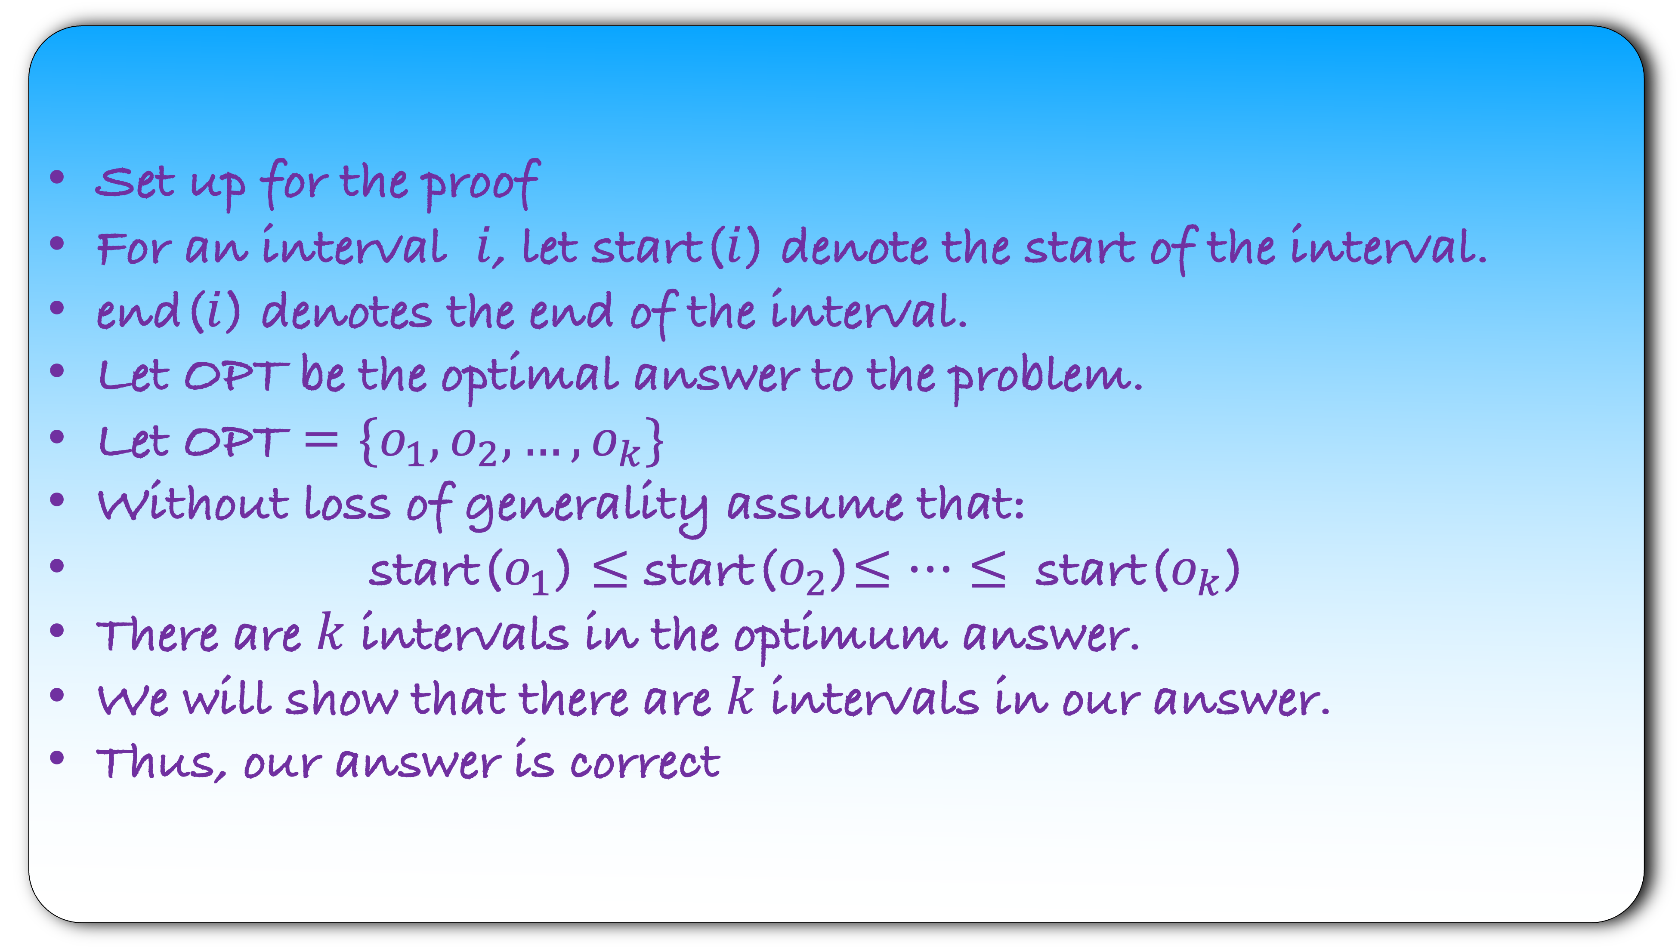
Set up for the proof
For an interval $i$, let start($i$) denote the start of the interval.
end($i$) denotes the end of the interval.
Let OPT be the optimal answer to the problem.
Let OPT = $\{o_{1},o_{2},…,o_{k}\}$
Without loss of generality assume that:
start($o_{1}$) $≤$ start($o_{2}$)$≤…≤$ start($o_{k}$)
There are $k$ intervals in the optimum answer.
We will show that there are $k$ intervals in our answer.
Thus, our answer is correct

Slide 3
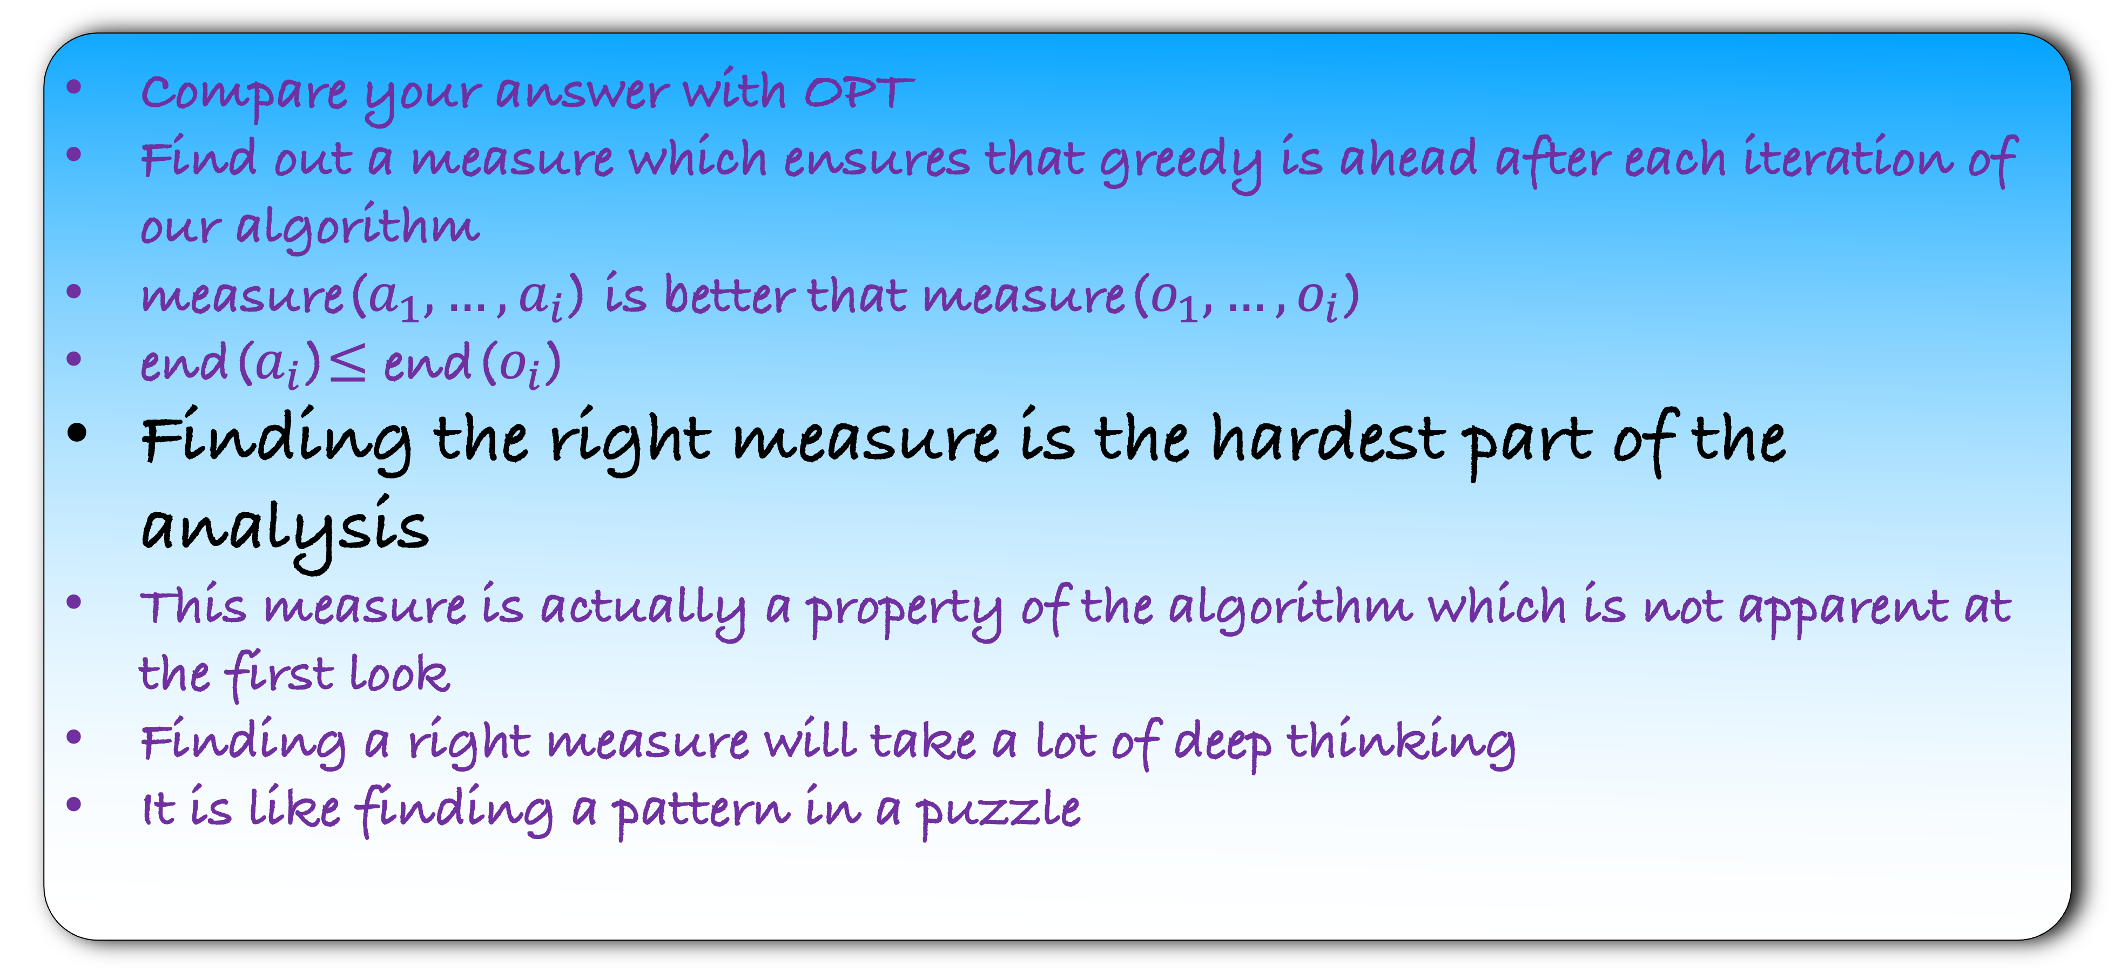
Proof Strategy: Greedy is ahead than the optimum
Compare your answer with OPT
Find out a measure which ensures that greedy is ahead after each iteration of our algorithm
measure($a_{1},…,a_{i}$) is better that measure($o_{1},…,o_{i}$)
end($a_{i}$)$≤$ end($o_{i}$)
Finding the right measure is the hardest part of the analysis
This measure is actually a property of the algorithm which is not apparent at the first look
Finding a right measure will take a lot of deep thinking
It is like finding a pattern in a puzzle

Slide 4
Another Proof Strategy: Exchange argument
Start with the optimum and our answer
Gradually exchange parts of the optimum with your answer, ensuring that each step maintains optimality
Through repeated iterations, this process transforms the optimum into your answer

Slide 5
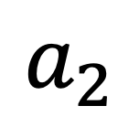
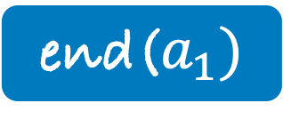
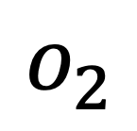
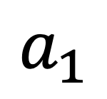
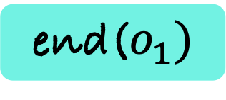
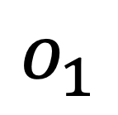
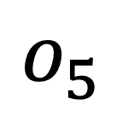
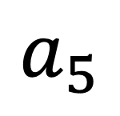
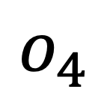
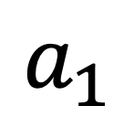
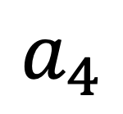
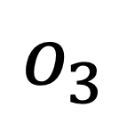
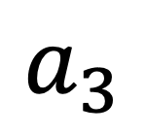

end($a_{1})$
end($o_{1})$
$$o_{1}$$
$$o_{2}$$
$$o_{3}$$
$$o_{4}$$
$$o_{5}$$
$$a_{1}$$
$$a_{1}$$
$$a_{2}$$
$$a_{3}$$
$$a_{4}$$
$$a_{5}$$
Change $o_{1}$ by $a_{1}$

Slide 6
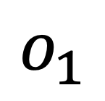
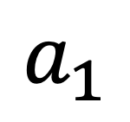
$$o_{1}$$
end($a_{1})$
end($o_{1})$
$$a_{1}$$
$$o_{2}$$
$$o_{3}$$
$$o_{4}$$
$$o_{5}$$
$$a_{1}$$
$$a_{2}$$
$$a_{3}$$
$$a_{4}$$
$$a_{5}$$
Change $o_{1}$ by $a_{1}$

Slide 7
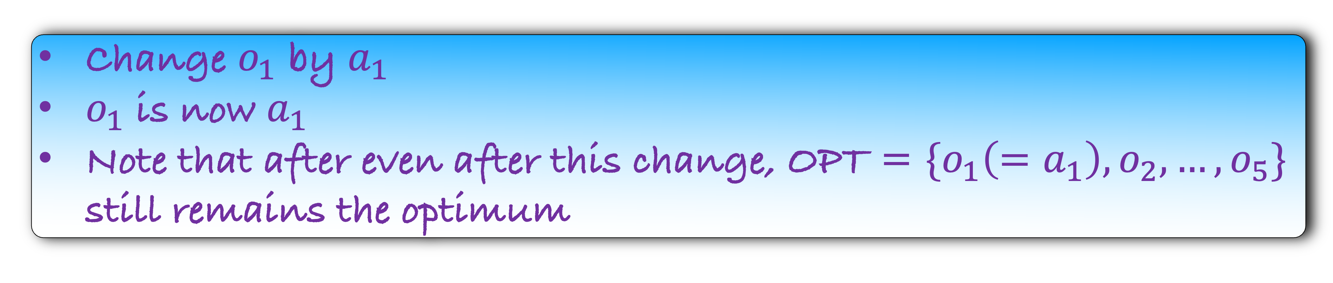
end($a_{1})$
end($o_{1})$
$$a_{1}$$
$$o_{2}$$
$$o_{3}$$
$$o_{4}$$
$$o_{5}$$
$$a_{1}$$
$$a_{2}$$
$$a_{3}$$
$$a_{4}$$
$$a_{5}$$
Change $o_{1}$ by $a_{1}$
$o_{1}$ is now $a_{1}$
Note that after even after this change, OPT = $\{o_{1}\left(=a_{1}\right),o_{2},…,o_{5}\}$ still remains the optimum

Slide 8
end($a_{1})$
$$a_{1}$$
$$o_{2}$$
$$o_{3}$$
$$o_{4}$$
$$o_{5}$$
$$a_{1}$$
$$a_{2}$$
$$a_{3}$$
$$a_{4}$$
$$a_{5}$$
Change $o_{1}$ by $a_{1}$
$o_{1}$ is now $a_{1}$
Note that after even after this change, OPT = $\{o_{1}\left(=a_{1}\right),o_{2},…,o_{5}\}$ still remains the optimum

Slide 9
end($a_{1})$
$$a_{1}$$
$$o_{2}$$
$$o_{3}$$
$$o_{4}$$
$$o_{5}$$
$$a_{1}$$
$$a_{2}$$
$$a_{3}$$
$$a_{4}$$
$$a_{5}$$
Lemma: There is an optimum that starts with $a_{1}$

Slide 10
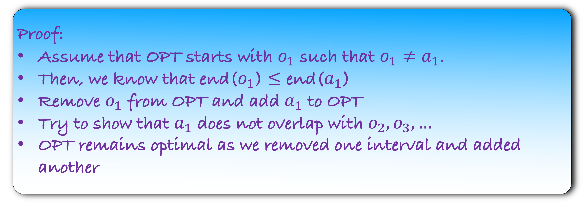
Lemma: There is an optimum that starts with $a_{1}$
Proof:
Assume that OPT starts with $o_{1}$ such that $o_{1}≠a_{1}$.
Then, we know that end($o_{1}$) $≤$ end($a_{1}$)
Remove $o_{1}$ from OPT and add $a_{1}$ to OPT
Try to show that $a_{1}$ does not overlap with $o_{2},o_{3},…$
OPT remains optimal as we removed one interval and added another

Slide 11
end($a_{1})$
$$a_{1}$$
$$o_{2}$$
$$o_{3}$$
$$o_{4}$$
$$o_{5}$$
$$a_{1}$$
$$a_{2}$$
$$a_{3}$$
$$a_{4}$$
$$a_{5}$$
Lemma: There is an optimum that starts with $a_{1}$
Do you see now how to proceed in the proof?
Repeat the process

Slide 12
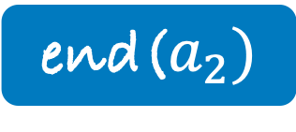
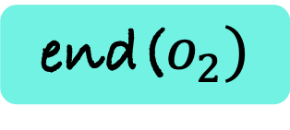
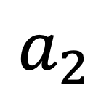
end($a_{2})$
end($o_{2})$
$$a_{1}$$
$$o_{2}$$
$$o_{3}$$
$$o_{4}$$
$$o_{5}$$
$$a_{1}$$
$$a_{2}$$
$$a_{2}$$
$$a_{3}$$
$$a_{4}$$
$$a_{5}$$
Lemma: There is an optimum that starts with $a_{1}$
Do you see now how to proceed in the proof?
Repeat the process

Slide 13
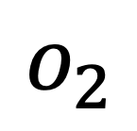
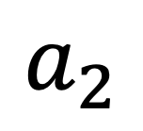
$$o_{2}$$
end($a_{2})$
end($o_{2})$
$$a_{1}$$
$$a_{2}$$
$$o_{3}$$
$$o_{4}$$
$$o_{5}$$
$$a_{1}$$
$$a_{2}$$
$$a_{3}$$
$$a_{4}$$
$$a_{5}$$

Slide 14
end($a_{2})$
$$a_{1}$$
$$a_{2}$$
$$o_{3}$$
$$o_{4}$$
$$o_{5}$$
$$a_{1}$$
$$a_{2}$$
$$a_{3}$$
$$a_{4}$$
$$a_{5}$$
Lemma: There is an optimum that starts with $\{a_{1},a_{2}\}$

Slide 15
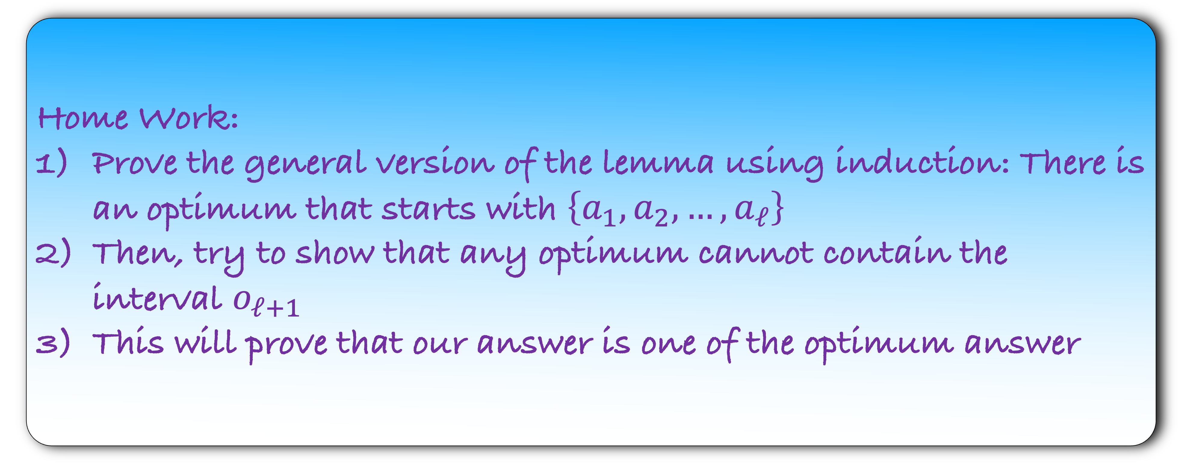
Lemma: There is an optimum that starts with $\{a_{1},a_{2}\}$
Can you generalize this lemma?
Home Work:
Prove the general version of the lemma using induction: There is an optimum that starts with $\left\{a_{1},a_{2},…,a_{ℓ}\right\}$
Then, try to show that any optimum cannot contain the interval $o_{ℓ+1}$
This will prove that our answer is one of the optimum answer

